Slide 1

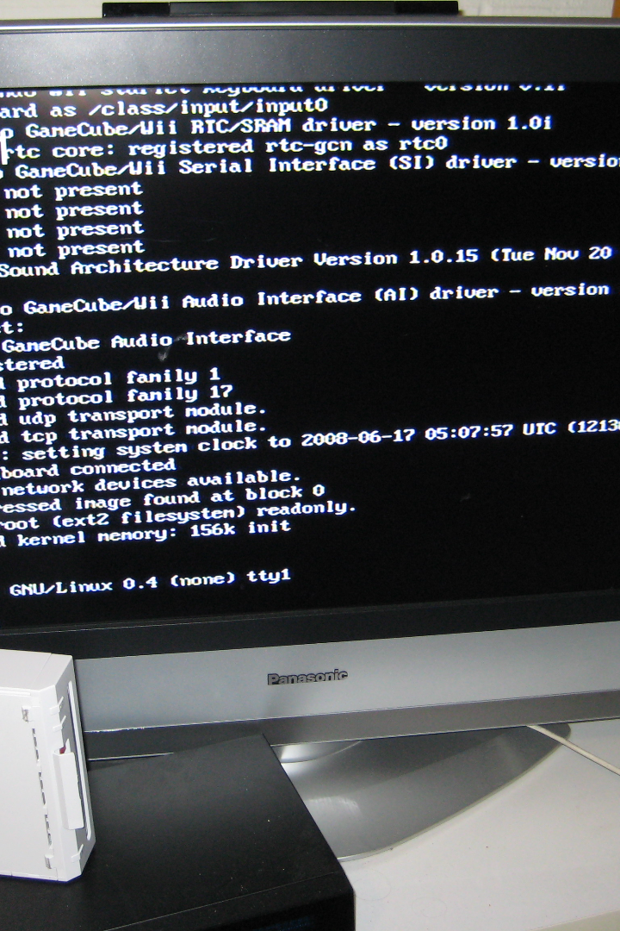


Exploring System Calls in Linux
Linux system calls provide an interface between applications and the Linux kernel, offering developers power, flexibility, and control to efficiently manage their systems. Let's dive deeper.
by ARRAMREDDY ROSHINI

Slide 2

What are System Calls?
System calls are a fundamental part of OS programming that enable applications to access and interact with the lower level functionalities of the operating system. They provide an abstraction layer that isolates applications from the hardware.
Common types
Process Control, File Management, Device Management, Communication and Memory Management
System Calls
read(), write(), open(), close(), fork(), exec(), wait(), exit()
Examples
Executed by libraries linked to running programs. They could be as low-level as the kernel or as high-level as reading a file.

Slide 3

Process Control System Calls
The system calls used to manage processes fall under process control system calls. They allow processes to create new processes, execute programs, and manage program memory and priorities.
1
fork()
Create a new child process as a copy of the calling process.
wait()
2
Wait for the child process to terminate.
3
exec()
Replace the current process image with a new process image.

Slide 4



File Management System Calls
File management system calls manage files and directories, controlling access, creating, deleting, opening, closing, reading and writing files.
open()
write()
close()
Open a file
Write to a file
Close a file

Slide 5

Device Management System Calls
The device management system calls are used to interface with external and internal peripherals and hardware devices, including the hard disk, network adapters, printers, and other components.
1
ioctl()
Change device settings and send control messages.
2
read()
Read data from a device.
3
write()
Write data to a device.

Slide 6

Communication System Calls
Communication System Calls are used for inter process communication between two or more processes on the same or different computers over a network.
Types
Functions
Local IPC and Remote IPC
pipe, shmget, shmctl, msgsnd, msgrcv

Slide 7



Memory Management System Calls
Memory allocation System Calls are used to allocate memory for different purposes, such as dynamic memory allocation, shared memory allocation, memory deallocation, and memory management.
malloc()
calloc()
free()
Dynamically allocate memory.
Dynamically allocate elements of an array and initialize them to 0.
Deallocate previously allocated memory.

Slide 8
Examples of System Calls in Linux
Many common command-line programs in Linux are implemented through system calls.
The 'ls' command uses open() to open directories and files, readdir() to read directory contents, and closedir() to close directories.
The 'ps' command uses fork() to create a new process to list the system processes, and wait() to wait for it to complete.
The 'cat' command displays the contents of a file by repeatedly calling read() and write().

Slide 9
Benefits of Using System Calls
System calls provide several benefits and advantages, including allowing for multitasking, efficient memory management, and better control over hardware resources. It also allows for compatibility with other programming languages and operating systems.
1
Resource Control
Allows better control over resources, avoiding deadlocks and infinite loops.
Error detection and handling.
2
Provides a convenient way to handle and recover from errors and prevent data loss.
3
Robust Security
Maps user requests to kernel modules and performs necessary privilege checks to ensure system security.

Slide 10

Conclusion
System calls play an essential role in the functioning of the Linux kernel and provide an efficient, versatile platform for software development. Understanding the use and benefits of system calls is critical for programming in the Linux environment.

